Slide 1
EPA Mileage - Curb Weight Internet Activity for Introductory Calculus Physics II
AAPT Summer Meeting
July 24, 2017
Brenda Skoczelas, Dept of Natural Sciences
Lake-Sumter State College
Dave Ober, Physics & Astronomy Dept
Ball State University

Slide 2
Outline: Predicting Vehicle MPG with Curb Weight
Internet activity for General Education class - 2010
Internet activity for Calculus-based Physics II class - 2017
Selected examples of student results
Feedback from students – design of activity, what students liked best/least, and their redesign suggestions
Instructor observations and lessons learned
Notes:
Original Activity has been adapted over the years.

Slide 3
EPA Mileage vs. Curb Weight Internet Activities
SCIN 101 – (4 hours), Science of Traditional and Alternative Energy – General Education Course
Internet activity introduced in 2010-2011 as a one-week laboratory activity; used through 2013-2014
Course Introduces the basic physical concepts in understanding the science of different forms of energy
Course considers science of transportation and energy storage that reduce environmental impact
Notes:
I was a Math Major at BSU. Physics Minor and PhysTec during my Honors Thesis Project. Graduate Degree in Applied Physics at BSU. Dr. Ober Dept Chair. Graduated in 2009 and took a high school teaching position. After one year, I was hired at Ivy Tech Community College to teach Math and Physical Science courses. My very first year, I was assigned SCIN 101 Traditional And Alternative Energy. It had not been taught for several years. Emphasize Gen Ed course. Pre Req Algebra 1.
Mentor Dr. Ober helped me prepare for my course load and design activities for this new (to me) lab course.
Emphasize Gen Ed course. Pre Req Algebra 1. Required by??
Pros and Cons of each type of energy source.

Slide 4
Activity Instructions
Prepare an Excel Spreadsheet (table) for your vehicle data that includes the following information about the vehicles that you are investigating:
Year | Make | Model | FWD or AWD | Cylinders (4, 6, ...) | EPA Mileage |  |  | Weight | Electric, Gasoline, Diesel, or Hybrid
 |  |  |  |  | City | Highway | *Combined
2017 | Ford | Escape | FWD | 4 | 19 | 29 | - | 3552 | G
*Combined fuel economy is a weighted average of City and Highway MPG values that is calculated by weighting the City value by 55% and the Highway value by 45%
Notes:
Explain the Excel sheet.
Depending upon the size of the class, groups or individual students are assigned a specific EPA Class Size of Vehicle. Ranges from Economy Size to Sedan to Large Trucks. The students might search for 10 different vehicles.
Students had an opportunity to look up technical information. This part they enjoyed.
By including the additional information, there was even more opportunity for analysis.

Slide 5
Sample Student Spreadsheet
Year | Make | Model | Drive | Cylinders | Fuel Economy |  |  | Engine Type | Curb Weight
 |  |  |  |  | City | Highway | Combined
2017 | Honda | CR-V | FWD | 4 | 28 | 34 | 30 | Gasoline | 3410
2017 | Mazda | CX-5 | FWD | 4 | 24 | 31 | 27 | Gasoline | 3591
2017 | Hyundai | Tucson | AWD | 4 | 26 | 32 | 28 | Gasoline | 3493
2017 | Ford | Escape | AWD | 4 | 22 | 28 | 24 | Gasoline | 3574
2018 | Chevrolet | Equinox | FWD | 4 | 26 | 32 | 28 | Gasoline | 3327
2017 | Kia | Sportage | FWD | 4 | 23 | 30 | 26 | Gasoline | 3535
2017 | GMC | Terrain | AWD | 6 | 16 | 23 | 18 | Gasoline | 3930
2017 | Subaru | Forester | AWD | 4 | 26 | 32 | 28 | Gasoline | 3504
2017 | Nissan | Rouge | FWD | 4 | 33 | 35 | 34 | Hybrid | 3526
2017 | Toyota | RAV4 | AWD | 4 | 34 | 30 | 32 | Hybrid | 3938
Notes:
Compact SUVs
The individual data would then be shared with the instructor and put in to one giant Master Excel Spreadhseet.

Slide 6
Notes:
Although the students were asked several questions related to the assignment (discuss later). the Excel Analysis of large set of data was done by the instructor for the Gen Ed course.
**Is anyone familiar with this rule? One of us became of aware this in 1979. Introduce the Rule of 80,000! Dumb luck beats good planning! Briefly Disucss xy = constant derivation. Heavy car and low mileage. 2000lb car gets about 40mpg or a 4000lb car gets 20mpg. Point on the graph to each point.
Power = Energy divided by time. Power times delta time = Energy in a gallon of gasoline (fixed amount). Force to overcome kinetic friction times velocity times delta time = energy. This reduces to Force times distance (miles) = fixed amount of energy in a gallon of gasoline.
The necessary force is proportional to the curb weight and the distance covered for a gallon of gasoline. Curb Weight times (mpg) = fixed amount of energy in a gallon of gasoline. How much energy in a gallon of gasoline?
Bonus question to students if they could explain the Rule of 80,000 with physics principles! Bonus challenge: Using work-energy concepts, can you develop a "rule of thumb" that will predict MPG for a given curb-weight?)
Expect higher efficiencies for diesel and hybrid curves!

Slide 7
EPA Mileage vs. Curb Weight Internet Activities
PHY 2049C – (5 hours), Physics II with Calculus – course for Science and Engineering Majors
Laboratories designed to further investigate and reinforce physical principles studied in classroom
Internet activity introduced during 2016-2017 as a two-week laboratory activity
Internet activity designed to strengthen data analysis skills (Excel) and provide opportunities to communicate findings (PowerPoint) as done by professionals in their fields
Notes:
I took a position as the Physics Instructor at LSSC in Aug 2014. No longer teaching SCIN 101 and stopped doing the activity. Summer of 2016, I was asked to present a Classroom Innovative Teaching Activity at a Master’s Teacher’s Conference. I spoke with Dr. Ober and we both agreed that the Mileage vs Curb Weight Acitivity would be good. I received very positive feedback from the conference and we decided to adapt it to fit in to the Introductory Physics w/ Courses. First attempt has been with the smaller Summer PHYS 2049C class of 10 students.
STEM Students with a Pre Req of Calc II, going on to 4 year University.
Analysis would be done by the students and Professional Presentations were given.

Slide 8
Activity Purpose
To provide students with an opportunity for:
Collaborative learning
Modeling real-world physics phenomena
Improving data analysis skills using Excel
Preparing research findings for presentation
Making professional meeting-type PowerPoint presentations

Slide 9
Activity Layout
Two two-hour laboratory periods are used for this activity
Students will first work in groups of two or three, and use the Internet to research technical information on vehicle Fuel Economy ratings and Curb Weight for assigned EPA Class Sizes.
Each group’s smaller data sets will then be SHARED with all groups
During the second week, groups will organize and analyze a larger set of data, and present their findings in a professional meeting format
Notes:
Rather than sharing the data with instructor, it is shared with entire class.

Slide 10
Analysis Guidelines of MPG vs. Curb Weight Data
Determine whether there may be any possible “Outliers“
Linear models are often attempted to model observations. Does a linear model describe your data? Does the y-intercept and/or does the x-intercept have any physical significance?
Develop a “best fit” mathematical model/relationship between Curb Weight and Mileage. Display the equation and its R² value on graph.
What do you think may be the best function (linear, parabola, polynomial, hyperbola, exponential, etc.) that describes your data?
Do you have a physical argument to support your above choice?
Notes:
STEM Students were asked to analyze the large Master Excel File and present the analysis in a PPT presentation to the class.
Can you remove the outliers?
Most common fit to the intro students is linear. Great teaching opportunity, because a linear fit might work well for their 10 data points, but not for the entire set!
Intercepts have any physical meaning!?! Love this question!
Open ended, students were free to really investigate the different types of functions that may or may not describe their data.
Bringing in the physics concepts to explain the relationship.

Slide 11
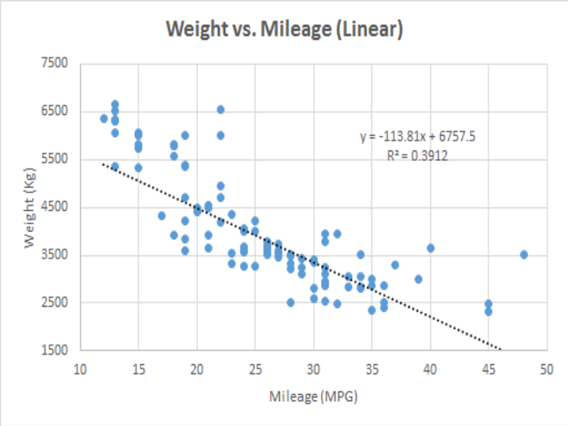
Notes:
We suggested a linear fit, significance to the intercepts!?!

Slide 12
Gas Efficiency Related to Curb Weight Combined
Common trend between all graphs: Negative slope
Negative slope implies that efficiency of gas mileage is inversely proportional to curb weight.
Exponential graph used due to lighter vehicles having much more fuel efficiency.
Notes:
Only group that went with a Power Fit. Show outliers and asked them to consider possible outliers.

Slide 13
Notes:
Our Analysis with the 2016-2017 Data. Would be discussed with the group after their presentations.
Power Fit: approach -1, but much smaller than 80,000 or 89, 000.
XY = constant 89,572 versus 78, 575 from 2010.
Very few Diesel, Hybrid, or Electric Vehicles. Not enough to analyze.
Different PV curves?

Slide 14
Summary of PHY 2049C Student Feedback
Instructor goals met in designing the activity
involved actual learning rather than simply following instructions
Student beliefs as to whether activity demonstrated reason(s) for laboratory
helped me understand the scientific process
Student beliefs that activity had characteristics of successful lab exercise
was interesting / engaging / fun
was an opportunity for collaboration
Notes:
We asked the students for their feedback immediately after the Presentations were finished, using a document created by Citrus College and adapted from the Science Faculty Inquiry Group on What comprises a successful Lab experience?
http://www.citruscollege.edu/stem/figs/Documents/Spr2013/Spr2013Science.pdf
Adapted from “What Comprises a Successful Lab Experience?”
Science Faculty Inquiry Group (FIG)
Report Spring 2013 by Kenneth Dery, Denise Kaisler, Christine Goedhart, Monica Montes, Barbara Juncosa, and Gloria Ramos
9/10, 9/10 and 10/10

Slide 15
Summary of PHY 2049C Student Feedback - II
What did you like best about this Activity?
“It was interesting seeing different ways of analyzing data in ways I had not thought of”
“I'm getting a new car soon, so this really helped me - what to look for”
Suggested Improvements:
“Request more data on diesel/hybrid/electric vehicles”
“Analyze the efficiency of your own vehicle”
What did you like least about this Activity?
“Even though I am proficient with Excel, graphs were hard to create”
“Lack of data for certain types of vehicles”
“The limited year of cars considered - only 2017”
Notes:
Open ended comments.
New ways to analyze data.
First year college students may be looking for a vehicle.
Very little experience with larger sets of data and using different functions to model the data.
Lack of Diesel, Hybrid, Electric

Slide 16
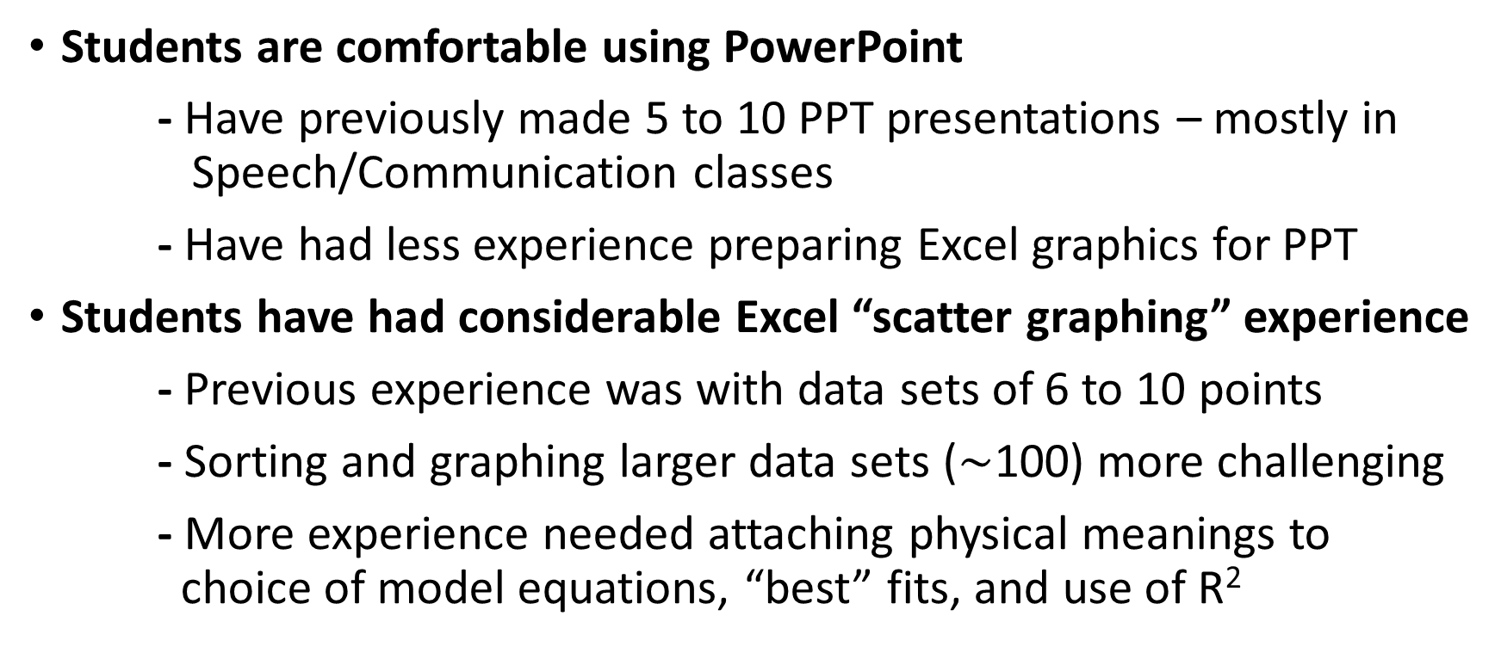
Several Observations and Future Considerations
Students are comfortable using PowerPoint
- Have previously made 5 to 10 PPT presentations – mostly in Speech/Communication classes
- Have had less experience preparing Excel graphics for PPT
Students have had considerable Excel “scatter graphing” experience
- Previous experience was with data sets of 6 to 10 points
- Sorting and graphing larger data sets ($\sim$100) more challenging
- More experience needed attaching physical meanings to choice of model equations, “best” fits, and use of R²
Notes:
When surveys, many of the students had made several prior PPT presentations in other courses, but less experience in Excel.
What is unique about this activity is the very large set of data provided to the students. Many labs require only a handful of trials and 6 – 10 data points that students then plot in Excel. And often linear fit.
Physical Meanings to choice of model equations.

Slide 17
Thank you!

